Slide 1


Slide 2
Final Design & Right of Way Acquisition Phase
A Project Manager’s Guide – December 2017
Notes:
Welcome to VDOT’s project manager’s guide to the final design and right of way acquisition phase. This training module will provide a brief introduction and overview to the topic.

Slide 3
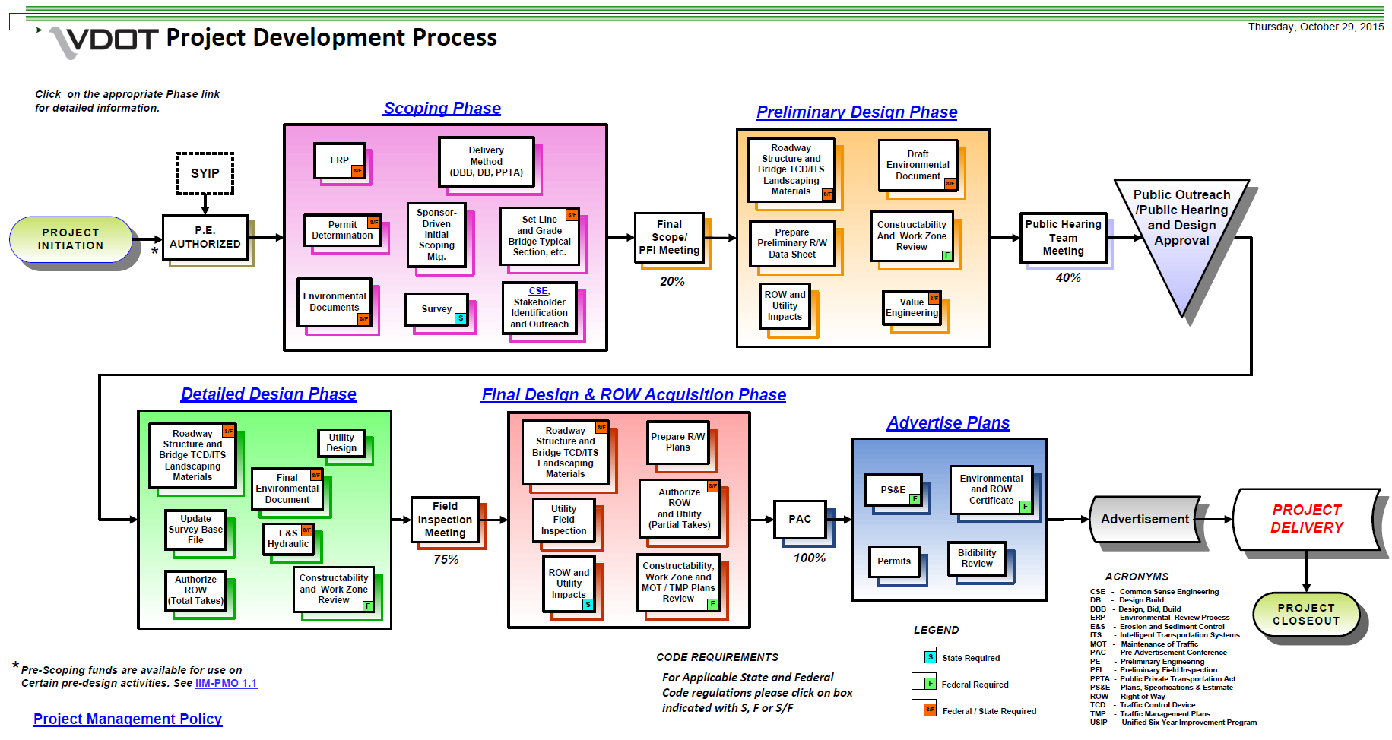
Final Design & Right of Way Acquisition Phase
Notes:
The VDOT Project Development process flowchart is a great resource to see the preliminary engineering project lifecycle. If you are not familiar with this flowchart, you should find the digital version at the link below the graphic and explore the hyperlinks in the flowchart. This presentation will focus on the portion of the process known as the Final Design and right of way acquisition Phase which begins after the FI meeting has been held. This Phase ends with the Pre Advertisement conference. This phase takes plans from 60% completion to 100% and includes completing the right of way acquisition and utility relocation process.

Slide 4
Preliminary Design Phase Overview
Project Initiation
Scoping Phase
Preliminary Design Phase
Detailed Design Phase
Final Design & ROW Acquisition Phase
  Field Inspection team meeting has been held and it is time to begin RW acquisition and prepare final design plans to include: (need to list what is added to the plans at this point)
Advertise Plans
Project Delivery/Project Closeout
Notes:
The final design and right of way acquisition comes after field inspection team meeting.

Slide 5
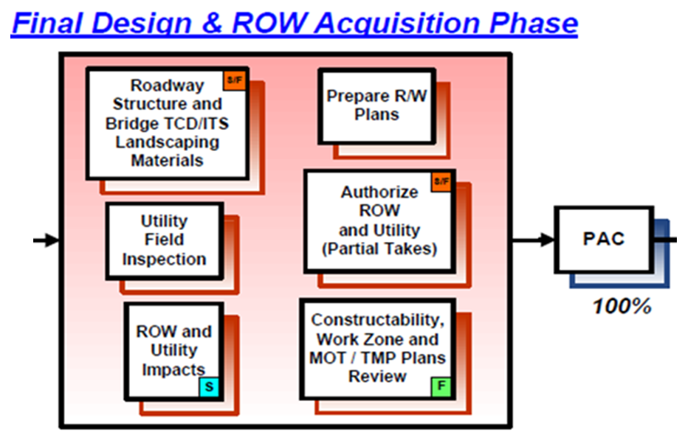
Final Design & Right of Way Acquisition Phase
Notes:
The Final Design and Right of Way Acquisition Phase Narrative provides the following list of tasks to be performed within this phase:
Finalizing the design of roadways, structures and bridges, traffic control devices/intelligent transportation systems, and landscaping
Finalizing right of way and utility impacts, erosion and sedimentation plans, and utility design
Obtaining environmental permits
Holding the utility field inspection, or UFI
Authorizing right of way and utilities
Performing constructability, work zone, maintenance of traffic/transportation management plan reviews
Holding the Pre-Advertisement Conference (PAC) team meeting

Slide 6
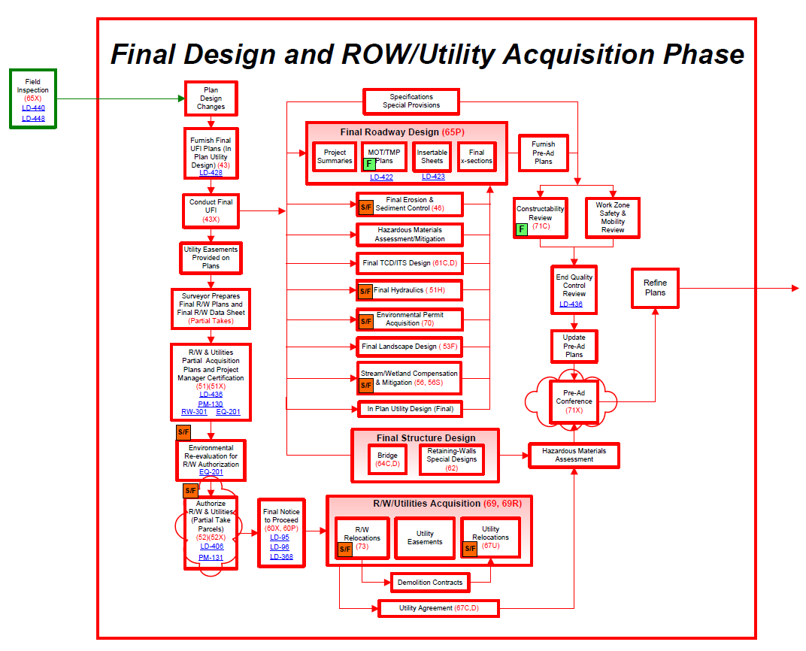
Final Design & Right of Way Acquisition Phase
  RW Acquisition Submission
Simultaneous Processes
  Acquire Right of Way and Relocation Utilities
  Finalize Roadway and Structure Designs
  Pre-Ad Preparation
Notes:
There is a sub-component of the Final Design and Right of Way Acquisition Phase that includes the Right of Way Submission and is discussed in the Right of Way Submission Design Aid Video.

Slide 7
Final Design & Right of Way Acquisition Phase
  RW Acquisition Submission
    (see previous video)
Simultaneous Processes
  Acquire Right of Way and Relocation Utilities
  Finalize Roadway and Structure Designs
  Pre-Ad Conference
Notes:
The Right of Way Submission aspect includes finalizing right of way and utility impacts and in-plan utility design, holding the utility field inspection, and authorizing right of way and utilities. For more information, please refer to Right of Way Submission Design Aid Video and IIM-LD-234 which is the IIM for “Right of Way Authorization Process for Projects with Total Take and Partial Take Parcel(s); and Projects with Partial Take Parcels only”.

Slide 8
Final Design & Right of Way Acquisition Phase
  RW Acquisition Submission
Simultaneous Processes
  Acquire Right of Way and Relocate Utilities
  Finalize Roadway and Structure Designs
  Pre-Ad Conference
Notes:
After the UFI meeting has been held, the project manager initiates another process that moves forward concurrently with the right of way submission and acquisition processes. This new – but concurrent – process, is considered Final Design.

Slide 9
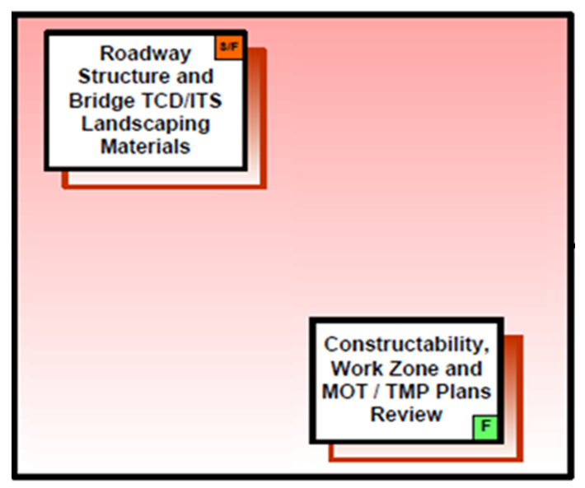
Final Design & Right of Way Acquisition Phase
Finalize Roadway and Structure Designs
  Finalizing the design of roadways, structures and bridges, traffic control devices/intelligent transportation systems, and landscaping
  Finalizing erosion and sedimentation plans and utility design.
  Obtaining environmental permits
  Performing constructability, work zone, Maintenance of traffic/transportation management plan reviews
Notes:
From the Project Development Flowchart, you can see there are two sub-blocks that are a part of final design that include the following:
Perform a thorough review of all correspondence and reports must be made to insure incorporation of applicable items into the plans
Finalizing the design of roadways, structures and bridges, traffic control devices/intelligent transportation systems, and landscaping
Finalizing erosion and sedimentation plans and in-plan utility design
Obtaining environmental permits
Request the federal CN number to be included on the title sheet.
Please be aware of any site-specific designs will require a request to Standards/Special Design Section, by memorandum, to prepare the required special design drawings. Exceptions to this procedure are requests for special design box culverts and special wing details, which are to be made by the Structure and Bridge Division.
At this time, the Project Manager should plan a date for the Pre Advertisement Conference (PAC) meeting based on the work remaining and the submission date in order to meet advertisement. Do NOT delay holding the Pre Advertisement Conference (PAC) meeting because of the advertisement date – the PM should hold the Pre Advertisement Conference (PAC) Meeting as soon as possible to ensure efficiency with the plan development process.

Slide 10
Final Design & Right of Way Acquisition Phase
  RW Acquisition Submission
Simultaneous Processes
  Finalize Roadway and Structure Designs
  Acquire Right of Way and Relocate Utilities
  Pre-Ad Conference
Notes:
Upon receiving Right of Way authorization and Notice to Proceed, the Right of Way Section begins to negotiate with property owners to acquire right of way and easements.
Once land acquisition in complete, the Utility section will provide notice to utility owners to proceed with relocation of utilities.
Note that any changes made to design plans may affect right of way acquisition, utility adjustments or railroad agreements. The Right of Way Section should be notified immediately.

Slide 11
Final Design & Right of Way Acquisition Phase
  RW Acquisition Submission
Simultaneous Processes
  Acquire Right of Way and Relocate Utilities
  Finalize Roadway and Structure Designs
  Pre-Ad Conference
  Inter-disciplinary milestone for the project team to review the final plans, bid documents and make any MINOR ADJUSTMENTS
Notes:
After the final design has been completed, provide the Pre-Advertisement Conference, or PAC plans to the team so they can perform constructability, work zone, maintenance of traffic/transportation management plan reviews.
Plans are then updates based on PAC comments and the Project Manager informs all stakeholders that the plans are available for the PAC Meeting.
Check with your Construction team member to make sure the Construction Time Determination Report is finalized.
Make sure you have a COMPLETE PAC AASHTOWare Preconstruction Estimate (previously TRNSPORT) and an updated PCES Estimate.
Please note that at this stage of project development, the PAC milestone allows the project team to review the final plans and bid documents and make MINOR ADJUSTMENTS.

Slide 12
PAC – Pre-Advertisement Conference
  Verify with design team plans are complete
  Verify LD-436 Quality Control Review is available and complete [This is not a quality control check on the design. It is a quality control check on the adequacy of the information shown on the plans!]
  Ensure PAC Plans are available in Falcon Web Suite
  Verify the Construction Time Determination Report (CTDR) is finalized
  Distribute PAC Plans, AASHTOWare Preconstruction (aka TRNSPORT), CTDR, and LD-436 to appropriate team members
Notes:
Ask your team members to review their designs and LD-436 to make sure the design is complete and information shown on the plans is adequate.
Consultants or team members (for in-house designs) complete the LD-436 for their section. Best practice is to provide the LD-436 at the PAC meeting. Please note that the LD-436 is not a quality control check on the design, but a review to conformance to standards.
Check to make sure the PAC plans are available and notify team members and stakeholders. Provide team members the exact due date for comments.
Make all information available prior to the PAC meeting.

Slide 13
PAC – Pre-Advertisement Conference
  Resolve any issues or open actions that would impact the submission of the plans to Construction and the subsequent advertisement date
  Communicate environmental commitments
  Update lessons learned through this milestone
  Confirm Request for Special Provisions has been submitted to Scheduling and Contract Division and verify anticipated completion date
  Ensure the estimate includes the final Construction Engineering Inspection (CEI) budget
  Review project risk associated with construction.
Notes:
The objective of the PAC meeting objective is to verify that right of way, utilities, and environmental permits are cleared, review MOT and sequence of construction, need for special provisions, and items required for advertisement. After the meeting, the Project Manager completes and sends out the PAC Team Meeting Report.
At the meeting, review:
The environmental commitments and conditions from the permits.
Risks associated with the project as expected during construction.
The final Construction Engineering Inspection budget and that it is included in the AASHTOWare Preconstruction Estimate.
After the PAC meeting, quickly resolve any issues or open actions that would impact the scope, schedule and estimate. Be sure to provide time in the schedule for plan adjustments and corrections.
As soon as issues are resolved from the PAC, complete PM-130 (Environmental Certification and Document Re-evaluation at PS&E) and provide to the District Environmental Manager. This Form initiates the reviews associated with the EQ-103 and EQ- 200 Forms.

Slide 14
Final Design & Right of Way Acquisition Phase
Finalize Roadway & Structure Designs
Right of Way Acquisition
Pre-Ad Conference
Notes:
In summary, as you work through the VDOT Project Development Process please keep in mind the need to actively manage your project and team members, all while realizing no two projects are identical. A major key to successful project development will be your ability to lead the team, which includes your ability to:
Initiate, facilitate, and track communication,
Establish reasonable expectations for deliverables,
Maintain and manage workflow between team members, and
Follow-up on any and all aspects of the project in a timely manner to ensure recovery is possible if something were to be behind schedule.

Slide 15
Tips for Success
Be proactive in preparing for the PAC meeting
Communicate effectively to all stakeholders
Be efficient running and closing out the PAC meeting
Notes:
Remember – being proactive and effective communication are very important to this part of the process.
We hope that this training module was helpful to better understand the topic.

